Slide 1

The 2020 US COVID-19 Pandemic
Trish Girmus
Dsc530 final project
11.21.2020

Slide 2
Introduction
The coronavirus disease, or COVID-19, is highly transmittable and contagious. The first discovery was made in Wuhan, China on December 31, 2019. In the US, the first discovery of COVID-19 was January 20, 2020. As of November 2020, total US known cases are over 12 million and continue to increase at an alarming rate. The US cumulative death rate currently is over a quarter of a million people.
For this exploratory data analysis, I took a data set from Kaggle, titled “Opportunity Insights real time Economic Tracker US”. I am only performing my analysis on one data set, which is the COVID-19 US state daily data. This data is cumulative and updated as the title mentions, in real time. The dates that encompass this data are January 21, 2020 through October 26, 2020.
As the goal of this project is to incorporate the skills and techniques we learned throughout this course, I took this data set as an opportunity to prove some of these answers already known.
My hypothesis /statistical question I would like to answer is, can we assume that the US average amount of cases per month is five million?
Sources:
https://www.kaggle.com/douglaskgaraujo/opportunity-insights-real-time-economic-tracker-us
https://en.wikipedia.org/wiki/Coronavirus_disease_2019
https://en.wikipedia.org/wiki/COVID-19_pandemic_in_the_United_States
The COVID Tracking Project. (n.d.). https://covidtracking.com/
The Economic Tracker. (n.d.). https://www.tracktherecovery.org/
Nytimes. (n.d.). Nytimes/covid-19-data. https://github.com/nytimes/covid-19-data

Slide 3
Variables
The covid_state_daily data set used for this analysis contains 17 variables. I reduced the total of variables for this project to five as I felt those were most relevant to answer my hypothesis.
These include:
Month – indicates the month of occurrences for case, test and death counts
Statefips – this is the two-digit ID code to represent states in the US.
- I did not include US territories for my analysis, but did include Washington D.C. There are 51 statefips in this analysis.
Case_Count* – confirmed number of COVID-19 cases
Death_Count* - confirmed number of COVID-19 deaths
Test_Count* - confirmed number of COVID-19 tests
*This is based on a 7-day moving average

Slide 4
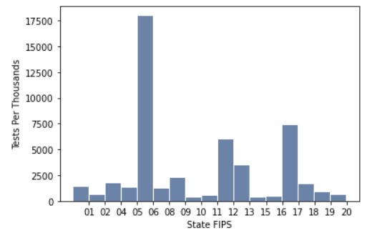
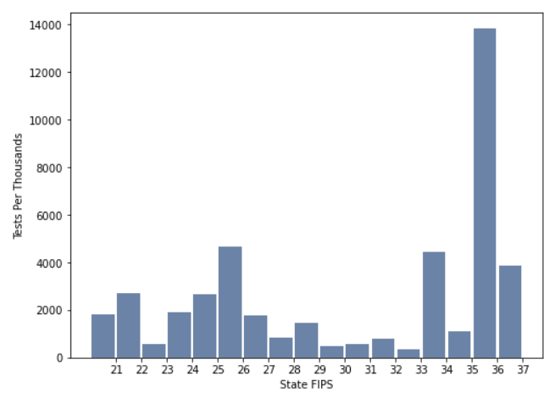
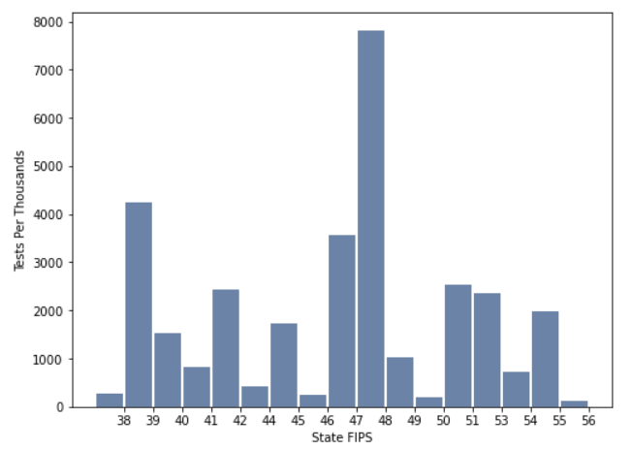
Histogram #1: Total Tests Per State
California (06), Florida (11), Illinois (17), New York (36) & Texas (48) are all outliers as these state totals are much higher vs. other states
Missouri (29) & Vermont (50) are lower end outliers
Removing these states (outliers) from the sample and reducing the sample size by not representing these states is a solution Mean is 2.4M tests
Mode is 6
Total # of Tests Per State (Alabama – Kansas)
Total # of Tests Per State (Kentucky – North Carolina)
Total # of Tests Per State (North Dakota – Wyoming)

Slide 5
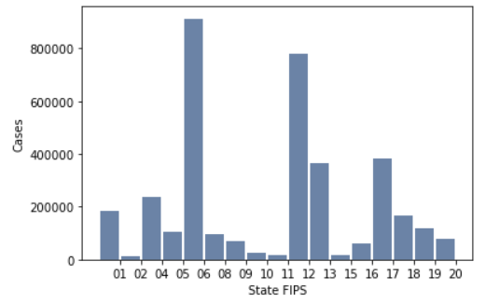
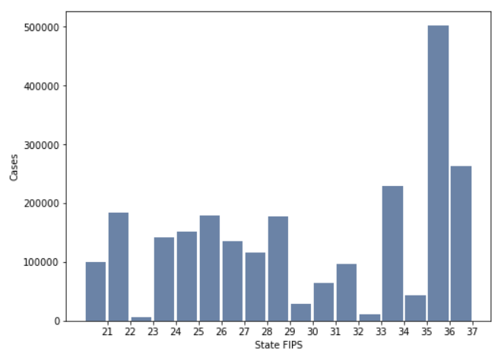
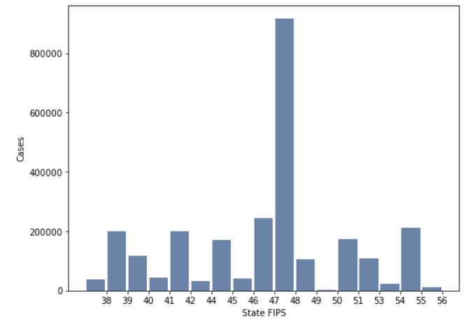
Histogram #2: Total Cases Per State
California (06), Florida (11), New York (36) & Texas (48) are all outliers as these state totals are much higher vs. other states
Maine (23) & Vermont (50) are lower end outliers
Removing these states (outliers) from the sample and reducing the sample size by not representing these states is a solution
Mean is 170,691 tests
Mode is 48
Total # of Cases Per State (Alabama – Kansas)
Total # of Cases Per State (Kentucky – North Carolina)
Total # of Cases Per State (North Dakota – Wyoming)

Slide 6
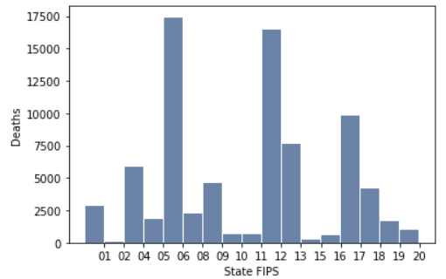
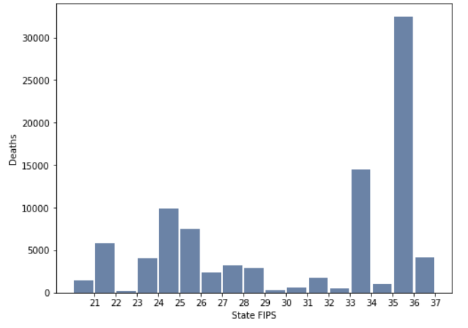
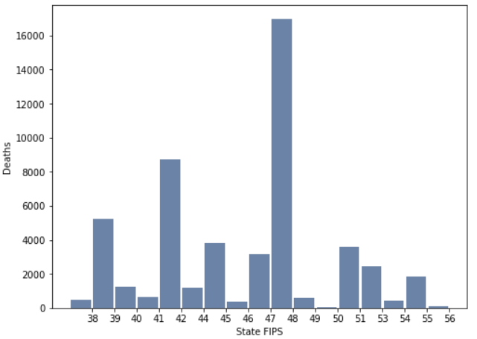
Histogram #3: Total Deaths Per State
California (06), Florida (11), New Jersey (34) & New York (36) are all outliers as these state totals are much higher vs. other states
Removing these states (outliers) from the sample and reducing the sample size is a solution
Mean is 4,336 deaths
Mode is 36
Total # of Deaths Per State (Alabama – Kansas)
Total # of Deaths Per State (Kentucky – North Carolina)
Total # of Deaths Per State (North Dakota – Wyoming)

Slide 7
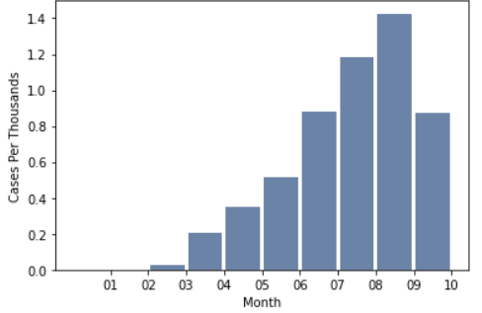
Histogram #4: Total Cases Per Month
In January, 12 cases were reported
October’s total cases are missing dates 10/27-10/31 due to the cut off when data was retrieved
As months have increased through the pandemic, deaths have also increased
Mean is 5,445,930 cases
July is the Median, October is the Mode
Cases Per Month

Slide 8
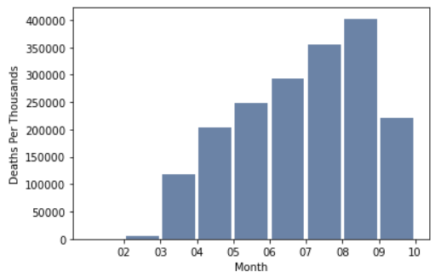
Histogram #5: Total Deaths Per Month
No deaths occurred in January
October’s death rates are missing dates 10/27-10/31 due to the cut off when data was retrieved
As months have increased through the pandemic, deaths have also increased
Mean is 184,644 deaths
July is the Median, October is the Mode
Deaths Per Month

Slide 9
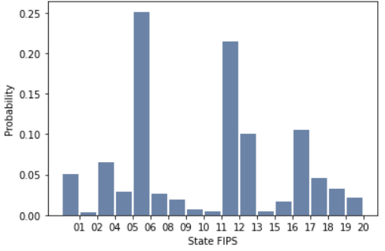
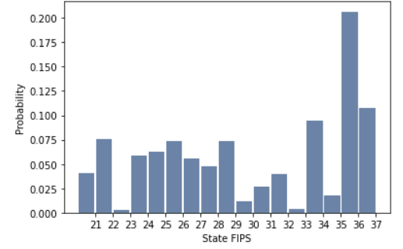
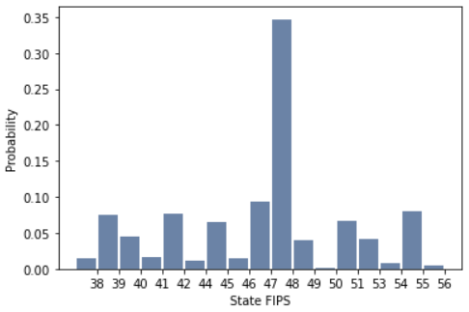
PMF: Probability of Cases by State
California (06), Florida (12), New York (36) & Texas (48) have highest probability of cases
Probability Per State (Alabama – Kansas)
Probability Per State (Kentucky – North Carolina)
Probability Per State (North Dakota – Wyoming)

Slide 10
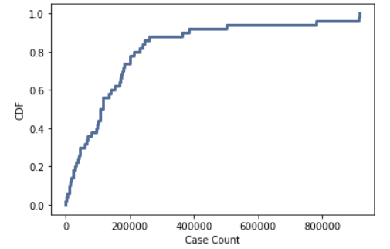
CDF: Case Count
Around 80% of states have over 200,000 cases which is above the mean
Mean: 170,112
Mode: 48
Median: 42

Slide 11
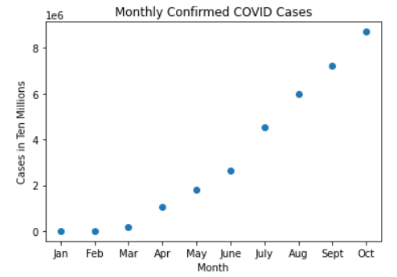
Scatterplot #1: Total Cases Per Month
As months have increased throughout the pandemic, so have the total number of cases
October’s death rates are missing dates 10/27-10/31 due to the cut off when data was retrieved
As months have increased through the pandemic, deaths have also increased
Mean is 3,216,813 cases
October is the mode
Median is 8

Slide 12
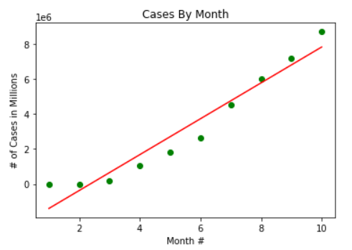
Linear Regression Analysis: Total Cases Per Month
Linear Regression Analysis performed looking at total cases per month
As months increase, total number of cases also increases – positive correlation
When performing a prediction of expected total of cases in 24 months, the predicted total is 22,184,610
Let’s hope there is a vaccine in the next 24 months!

Slide 13
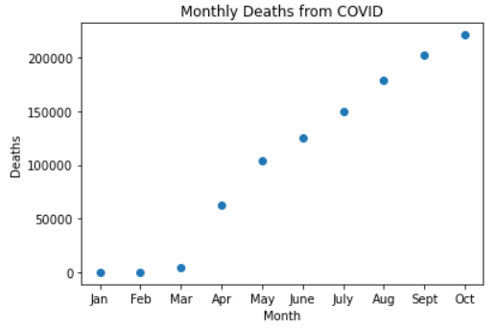
Scatterplot #2: Total Deaths Per Month
As months have increased throughout the pandemic, so have the total number of deaths
October’s death rates are missing dates 10/27-10/31 due to the cut off when data was retrieved
As months have increased through the pandemic, deaths have also increased
Mean is 104,932 deaths
October is the mode
Median is 8

Slide 14
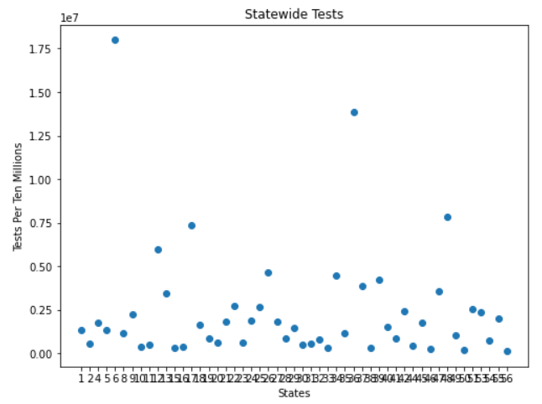
Scatterplot #3: Total # of State Tests in Millions
States that have highest total of cases as of 10/26/2020:
California (06): 17,982,829
New York (36): 13,834,240

Slide 15
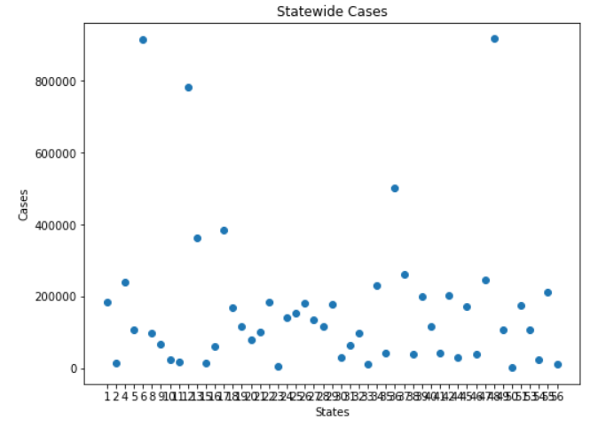
Scatterplot #4: Cases by State
States that have highest total of cases as of 10/26/2020: (also outliers)
California (06): 913,699
Florida (12): 782,005
New York (36): 501,393
Texas (48): 916,562

Slide 16
Hypothesis Testing: Are average monthly cases 5,000,000?
When performing a hypothesis test on average monthly cases:
The Null Hypothesis (h0) is 5,000,000 cases
The Alternate Hypothesis (h1) is not equal to 5,000,000 cases
When the hypothesis testing is conducted:
The sample mean is 3,216,313
The Null Hypothesis is rejected because the z value is is 0.58
Based on the hypothesis testing there is evidence that the average monthly cases are not 5 million

